Slide 1
Climate, health care and the race to zero Virginia Clinicians for Climate Action healthcare sustainability committee meeting August 3, 2023
Amy Collins md
Medical Director of physician engagement and education
Health Care Without Harm
@DrAmy_Collins

Slide 2
Health Care Without Harm
1996
Health Care Without Harm works to transform health care worldwide so that it reduces its environmental footprint, becomes a community anchor for sustainability and becomes a leader in the global movement for environmental health and justice.
44,000
Our reach includes 44,000 hospitals and health centers in 72 countries worldwide.
https://noharm.org
Notes:
Health Care Without Harm works to create change among hospitals and health systems through education, training, peer-learning, and implementation tools for health care sustainability. Aggregating the influence and purchasing power of the health sector, the Health Care Without Harm network drives the market toward sustainability and advocates for policies that will create worldwide social change.
HCWH has four regional offices (United States, Latin America (Argentina), Europe (Belgium), and Asia (the Philippines), and works through partner organizations in Australia, China, India, Nepal, South Africa, and Tanzania.
The Mercury Campaign: The Health Care Without Harm campaign to eliminate mercury started in a single Boston hospital and scaled up into a global collaboration with the World Health Organization. The world’s governments signed the Minamata Convention on Mercury in 2013, committing to phase mercury out of medical devices by 2020. On 16 August 2017, the Minamata Convention on Mercury entered into force, obliging countries from around the globe to phase out mercury-containing thermometers and blood pressure devices by 2020, and to phase-down their use of dental amalgam.
Today our focus is on the biggest global health threat of the 21st century, Climate Change.

Slide 3
Why focus on climate-smart health care?
We are running out of time
Climate is a global health threat
The health care sector contributes to the climate crisis
Extreme weather events can impact health care delivery, access and supply chains
Health professionals can be powerful advocates for climate solutions

Slide 4
Goals of the Paris Climate Agreement
Limit the average global temperature rise to well below 2°C above preindustrial levels and pursue efforts to limit this increase to 1.5°C*
Increase the ability to adapt to the adverse effects of climate change and enhance resilience
Align financial flows with these goals
https://sustainability.yale.edu/explainers/yale-experts-explain-paris-climate-agreement
*Need to halve greenhouse gas emissions by 2030 and achieve net-zero emissions by 2050

Slide 5
We are at a crossroads: it is now or never if we want to limit global warming to 1.5°C
“Without immediate and deep emissions reductions across all sectors, it will be impossible.”(IPCC Working Group III Co-Chair Jim Skea)
“We have the tools and know-how required to limit warming.”(IPCC Chair Hoesung Lee)
We have options in all sectors to at least halve emissions by 2030
https://www.ipcc.ch/2022/04/04/ipcc-ar6-wgiii-pressrelease/
Notes:
IPCC Working Group 3 report approved and released in April 2022

Slide 6
A final warning
“This report is a clarion call to massively fast-track climate efforts by every country and every sector and on every timeframe. Our world needs climate action on all fronts: everything, everywhere, all at once.” -António Guterres, UN Secretary General
https://www.theguardian.com/environment/2023/mar/20/ipcc-climate-crisis-report-delivers-final-warning-on-15c

Slide 7
US health care leaves a large climate footprint
The health care sector is responsible for 8.5% of U.S greenhouse gas emissions
Are the highest health care emissions per capita in the world*
Emissions rose 6% from 2012-2018
Resulted in the loss of 388,000 disability-adjusted life-years in 2018
82% of health care emissions are Scope 3, including the supply chain – food, pharmaceuticals, chemicals, medical devices, and supplies
Eckleman M., Sherman J. et.al. Health Care Pollution And Public Health Damage in the United States : An Update Health Affairs 2020
*The U.S. is the 1st in terms of health care sector GHG emissions accounting for 27% of the global health care footprint

Slide 8
Health care contributes to climate change
Energy use for heating, cooling, lighting, ventilation, equipment, computers, water heating, refrigeration & more
8.5% of U.S. greenhouse gas emissions
OR, waste anesthetic gases
Waste transport, treatment & disposal
Meat production, food transport and waste disposal
Fleet vehicles
Employee and patient commutes
Supply chain – pharmaceuticals food, supplies and devices
https://nursesclimatechallenge.org
Notes:
Health care is contributing to - and impacted by - greenhouse gas emissions.
The health care industry contributes almost 10% of U.S. greenhouse gas emissions. (Eckelman & Sherman, 2016)
Typical areas of largest impact are highlighted in the gray clouds. (Health Care Without Harm)
Hospitals are the second most energy-intensive facilities in the country and use 2.5 times more energy per square foot than other commercial buildings.
Hospitals are ranked as the third most water-intensive public buildings (after senior care facilities and hotels), using an average of 570 gallons per staffed bed per day. Water is also a major contributor to greenhouse gas emissions because of the energy needed to distribute, treat, and heat it.
Hospitals serve a lot of food to their staff, patients, and visitors. Since an estimated 14.5 percent of global greenhouse gas emissions come from the livestock sector hospitals can make a big difference by serving less meat.
U.S. hospitals generate 29 pounds of waste per patient day in the hospital. But the manufacturing process and transportation of the products purchased by U.S. hospitals also creates 32 pounds of waste for every pound of product manufactured.

Slide 9
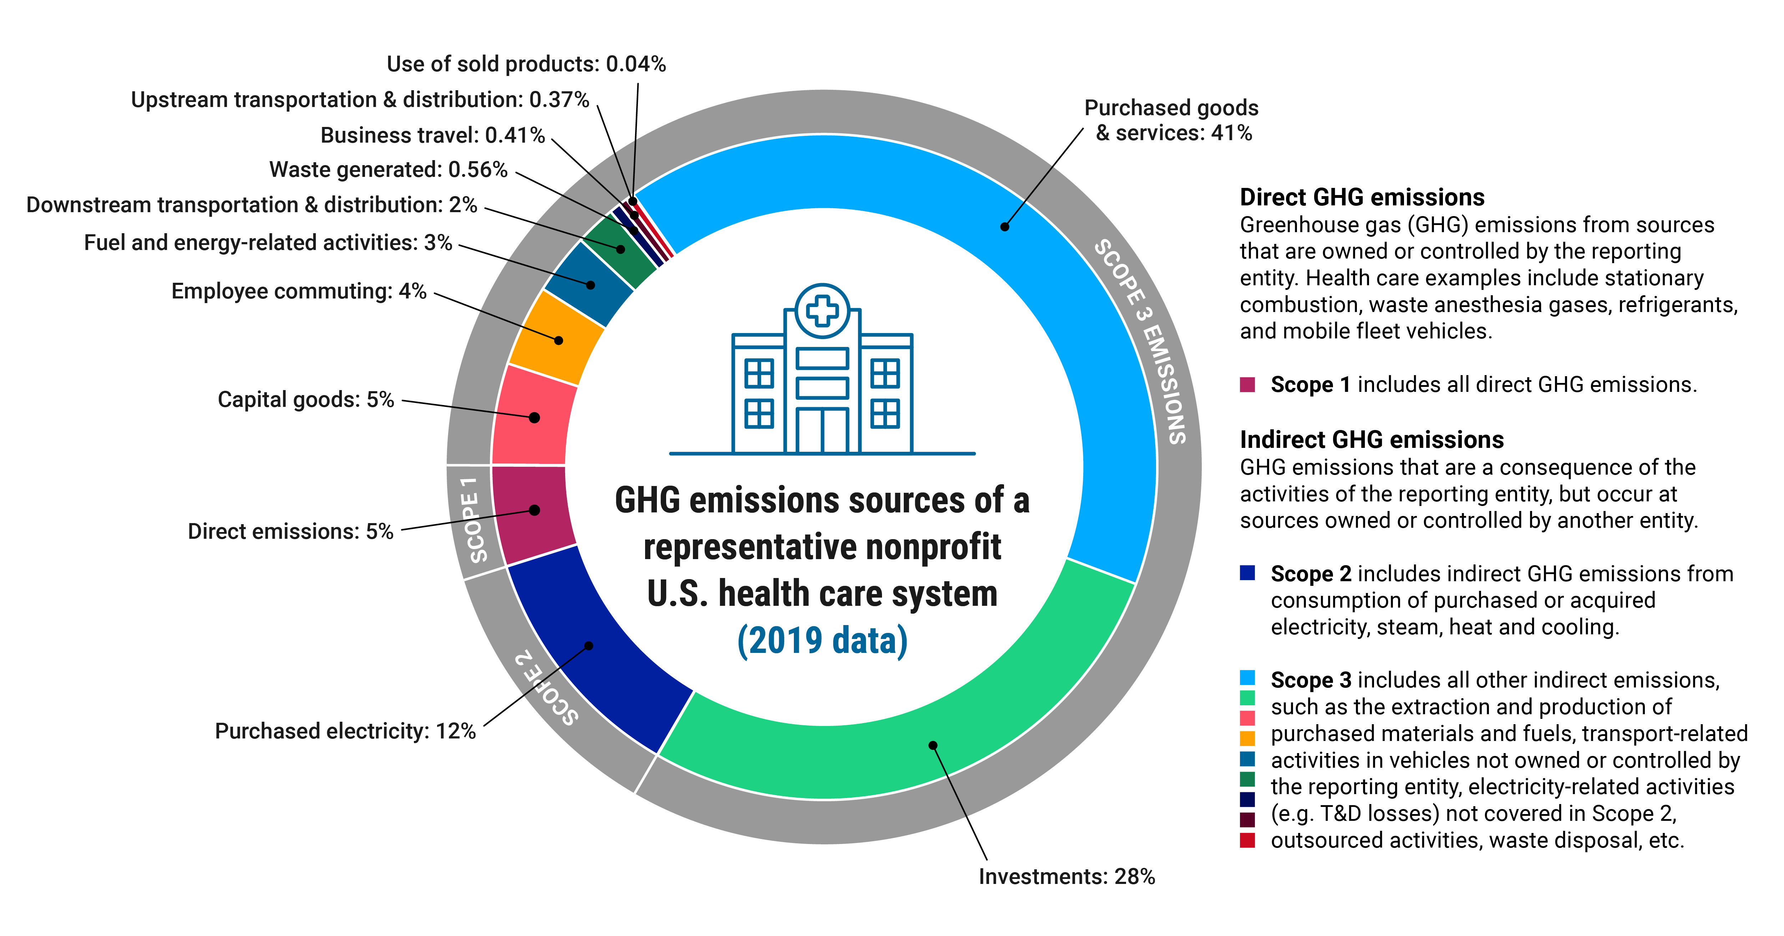
Greenhouse gas emission sources in health care
Practice Greenhealth

Slide 10
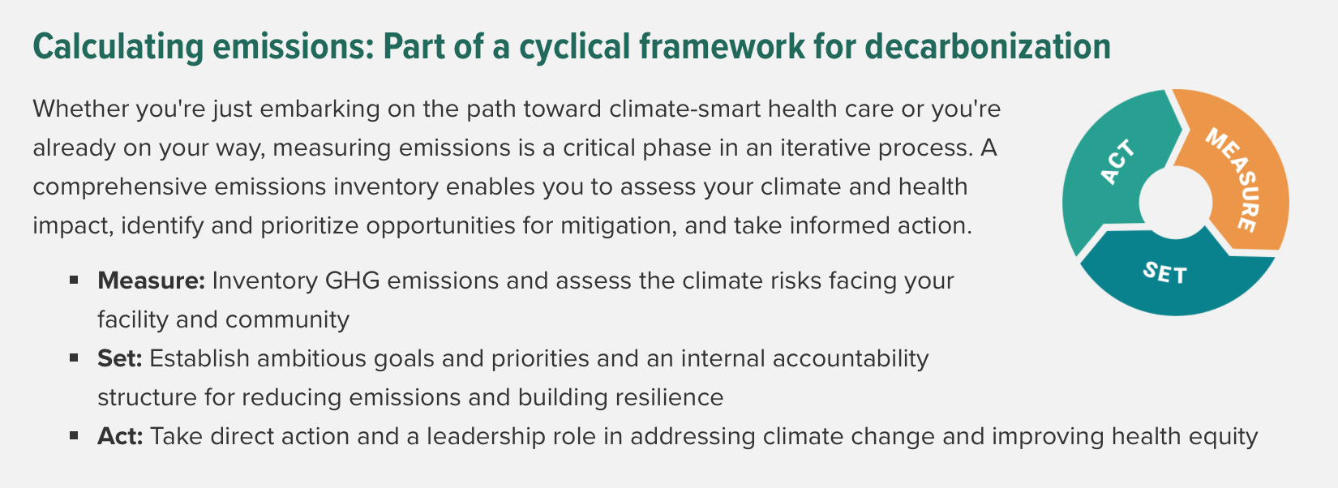
Health Care Without Harm Climate and Health Program
Supports the health care sector in:
Reducing its climate footprint
Preparing its facilities for climate impacts and building community resilience
Mobilizing its ethical, economic & political influence to advance climate-smart policies
https://noharm-uscanada.org/HealthyClimate
https://practicegreenhealth.org/tools-and-resources/health-care-emissions-impact-calculator

Slide 11
Practice Greenhealth
https://practicegreenhealth.org
Notes:
Membership organization promoting environmental stewardship and best practices for the health care sector

Slide 12
Clinician engagement
Trusted
White coat influence
Medical societies
Powerful health advocates
Impact of clinical care
https://noharm-uscanada.org/physiciannetwork
https://nursesclimatechallenge.org

Slide 13
Climate resilience
HEALTH CARE FACILITY RESILIENCE Health facilities and operations are prepared for continued service delivery in changing conditions
COMMUNITY HEALTH RESILIENCE Underlying determinants of health and strong social connections reduce climate impact and
enable communities to withstand and recover from adversity
PUBLIC INFRASTRUCTURE RESILIENCE Public infrastructure is able to withstand
disaster with essential services operating
and accessible

Slide 14
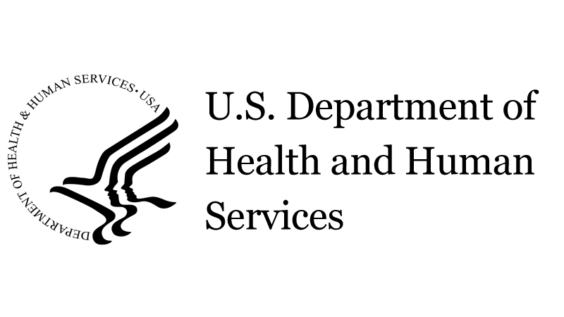
Momentum, reasons for hope and need for mandates
The Joint Commission announced that they are developing new requirements to address environmental sustainability for hospital accreditation programs
116 health sector organizations representing 872 hospitals have signed the Health Sector Climate Pledge as of April 12, 2023
Action Collaborative on Decarbonizing the US Health Sector: partnership of leaders from across the health system committed to addressing the sector’s environmental impact while strengthening its sustainability and resilience
COP-26 Health Programme
Inflation Reduction Act
CMS: Categorial Waiver for health care microgrid systems
Primer on Measures and Actions for Healthcare Organizations to Mitigate Climate Change to support healthcare organizations in advancing their decarbonization commitments.
Clinical Prioritization Tool for Health Care Decarbonization with recommended decarbonization interventions in 3 categories: waste anesthetic gases, metered dose inhalers and circularity
.

Slide 15
Global Road Map for Health Care Decarbonization Charting a global health care course to zero emissions by 2050 with climate resilience and health equity
Seven high impact actions
Power health care with 100% clean, renewable energy
Invest in zero emissions buildings and infrastructure
Transition to zero emissions, sustainable travel and transport
Provide healthy, sustainable food
Incentivize and produce low-carbon pharmaceuticals
Implement circular health care and sustainable health care management
Establish greater health system effectiveness
https://healthcareclimateaction.org/roadmap

Slide 16
How can health professionals take action?
Research
Individual action
Media
Hospital/health system
Education
Clinical practice
Public policy

Slide 17
Final reflections
I am only one, But still I am one. I cannot do everything, But still I can do something; And because I cannot do everything, I will not refuse to do the something that I can do.
Edward Everett Hale
Everyone cannot do everything but each of you can do one thing – Somaly Mam

Slide 18
Thank you!
Any questions or comments please contact me at acollins@hcwh.org
@DrAmy_Collins
https://noharm.org

