Slide 1


Slide 2


Climate Change and
Medical Education
Rebecca Philipsborn, MD, MPA
Emory University School of Medicine
Emory Resilience and Sustainability Collaboratory
May 8, 2021

Slide 3
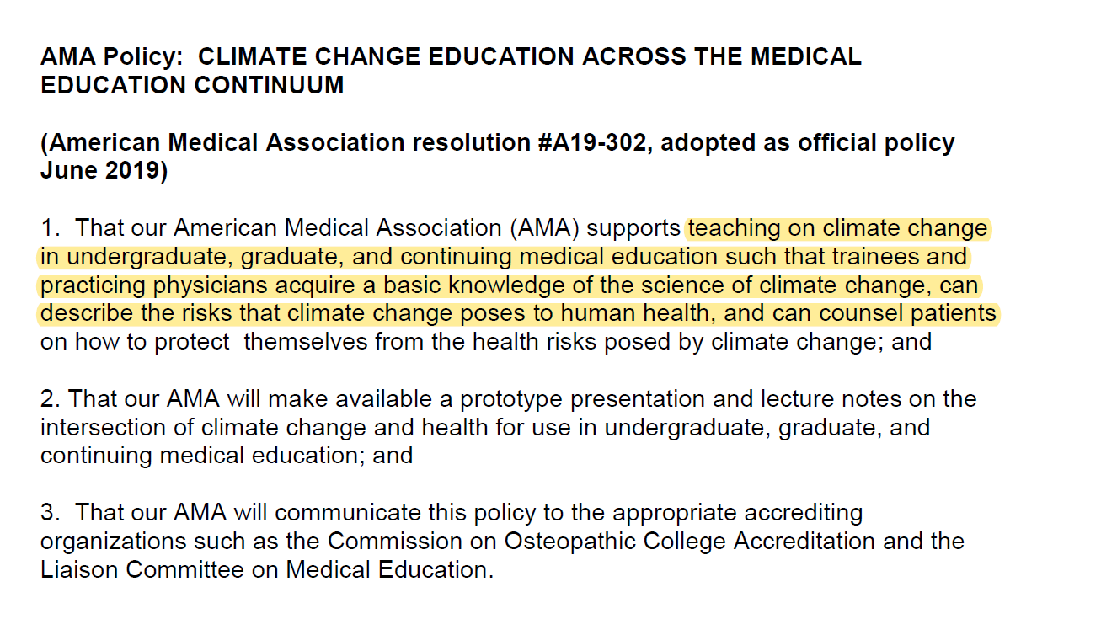

June 2019

Slide 4
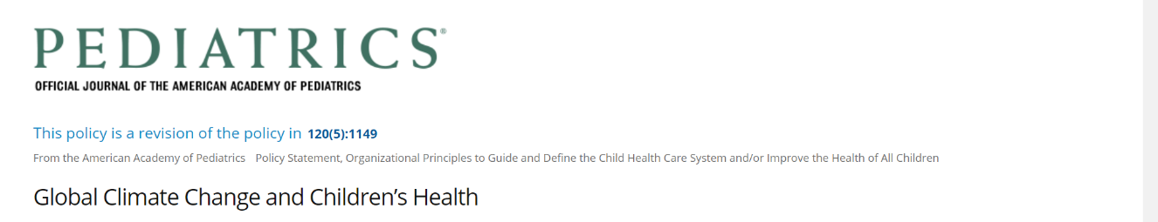
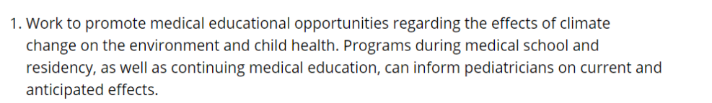

“…Failure to take prompt, substantive action would be an act of injustice to all children.”
November 2015
November 2007
https://pediatrics.aappublications.org/content/136/5/992

Slide 5




Urgency and the balance of time
To limit to 1.5°C - Reduce global emissions by 45% below 2010 levels by 2030 and be “net zero” by 2050.
-IPCC Special Report on Global Warming of 1.5°C

Slide 6
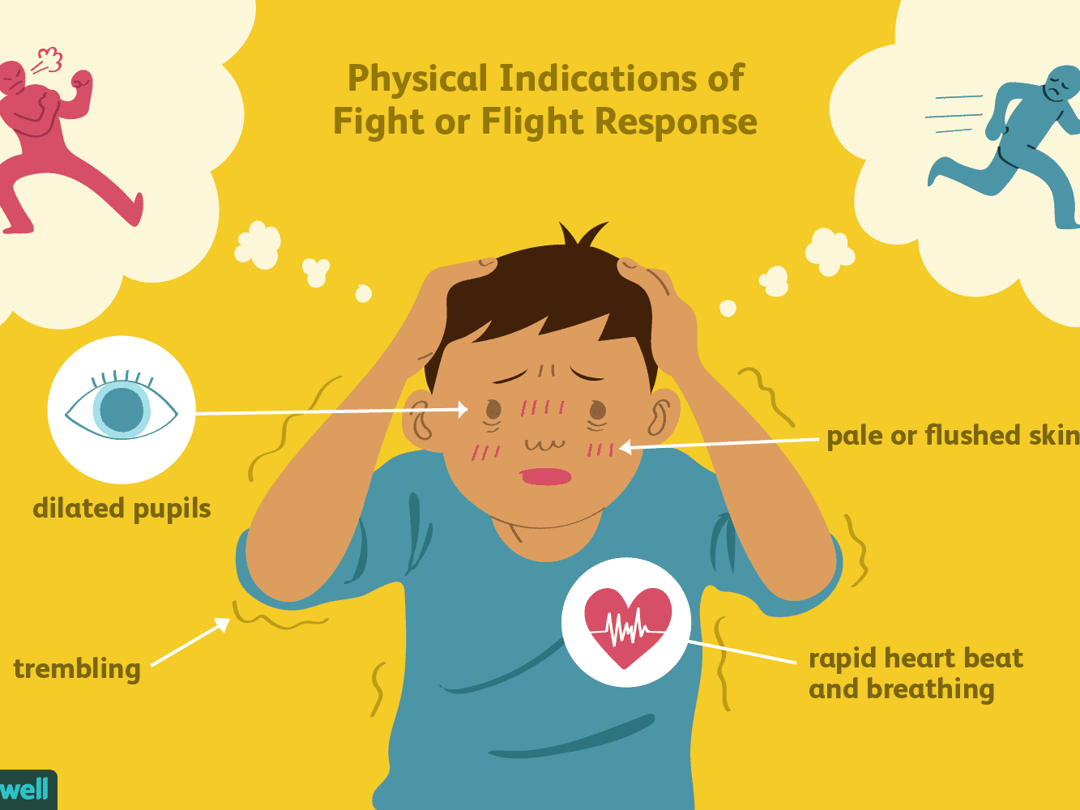

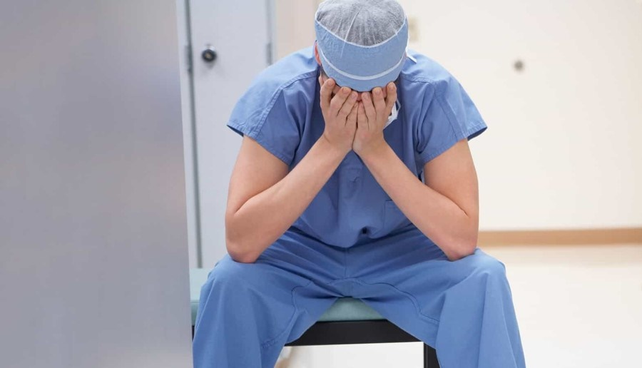
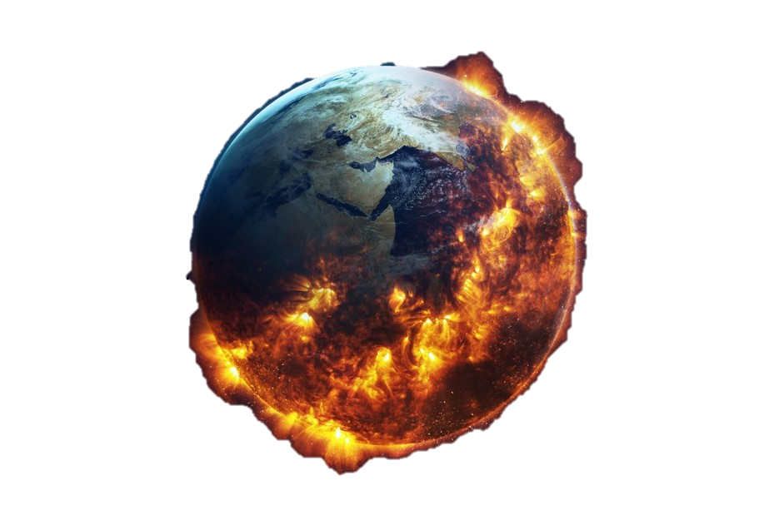
Burnt out
On fire
Image; verywellmind.com
“Climate Trauma”
Woodbury 2019. Ecopsychology. Volume: 11 Issue 1: February 25, 2019
Engagement in sustainability initiatives and climate action go hand-in-hand with wellness.
Physician image: Athena health
Earth image: vox.com

Slide 7

Attention to the climate crisis is integral—and essential—to the missions of our organizations

Slide 8
Big themes
Acknowledge the value of time
Start in your realm
Partner (co-create!) with your students and residents
Link to existing structures and topics (and events!)

Slide 9
Overview
2017
2018
2019
2020
2021
Pediatrics global health track
M3-M4 elective
Residency ed framework
M1-M2 foundations
Development
Implementation

Slide 10
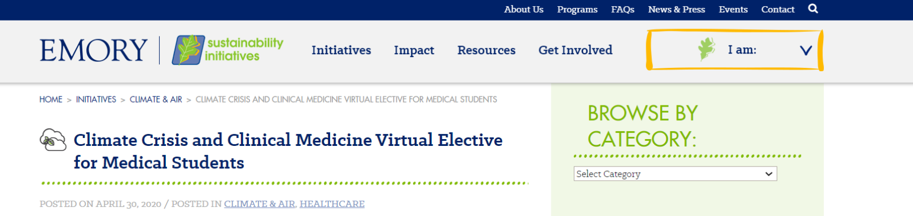
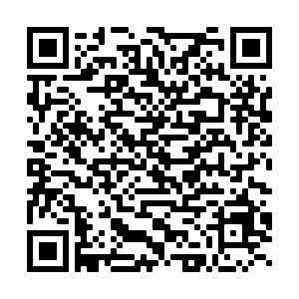
Major themes each week
  Climate change and emerging challenges
  Health equity and social justice
  Natural disasters, climate impacts, and solutions for the healthcare sector
  Climate communication
17 lectures by all-star guest lecturers (live-virtual with recordings available)
Opened up to students across the country
  230 registrants
  30 institutions represented
April 2020

Slide 11
Small groups and student engagement
Small Group Topics
Student Projects
Adapting your differential to a changing climate
Climate change and ethics in medicine
Climate disasters and resilient healthcare
Speaking climate to patients
Student-led presentations
Climate by systems “chalk talks”
Final project
  Heat sensitive medications table
  Patient resources/recourses for environmental determinates of health
  Recommendations for Emory’s healthcare sustainability plan
55 word reflections

Slide 12
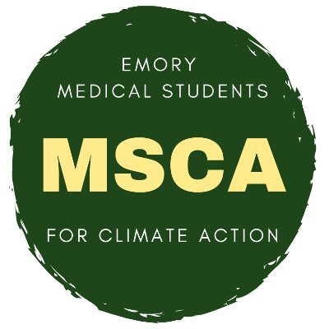
Student reflections
How has climate change imprinted on our consciousness?
Emaciated bears clinging to a solitary ice float.
Dumpsters drifting through flooded boulevards.
Family odysseys through Aegean islands to makeshift cities.
Urate crystals on microscopy, silica transported across alveoli.
A groundswell, not of water, but of doctors, patients, and those who care for justice and a livable planet.
~ Benjamin Rabin
@EmoryMSCA
The augmenter of all things unequal
It begins the moment you’re not but 200 cells.
But you’re strong.
Who knew it permeated the air you breath, the water you drink, the food you eat, the school you learn in?
But you are resilient.
Yet, you see, you shouldn’t have to be anything other than you.
~Emaline Laney

Slide 13
Overview
2017
2018
2019
2020
2021
Pediatrics global health track
M3-M4 elective
Residency ed framework
M1-M2 foundations

Slide 14
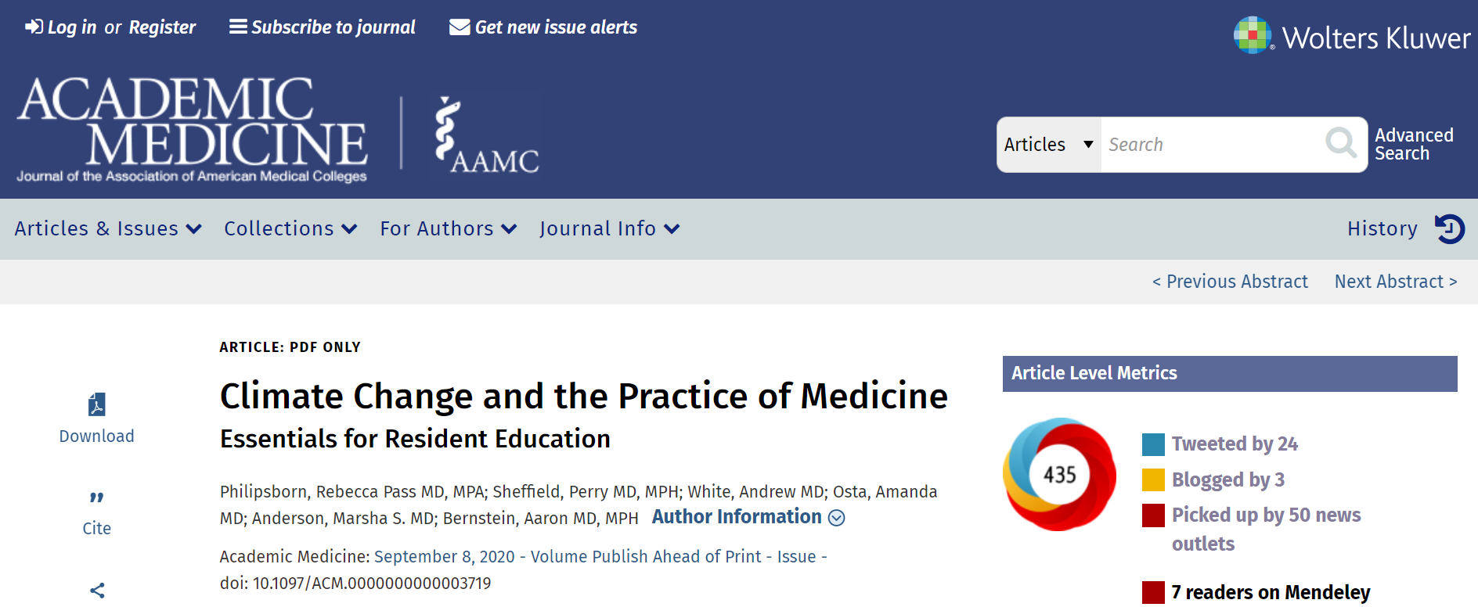
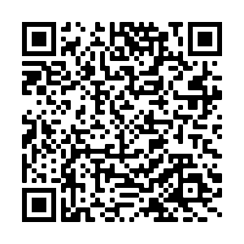
September 2020

Slide 15
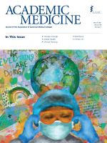
Collaborators
Perry Sheffield – Icahn School of Medicine at Mt. Sinai
Andrew White – Washington University School of Medicine
Amanda Osta – University of Illinois
Marsha Anderson – University of Colorado School of Medicine
Ari Bernstein – Harvard Medical School & Boston Children’s Hospital
In print:
March 2021

Slide 16
A curricular framework linked to ACGME core competencies,
detailing how climate change harms health…

Slide 17
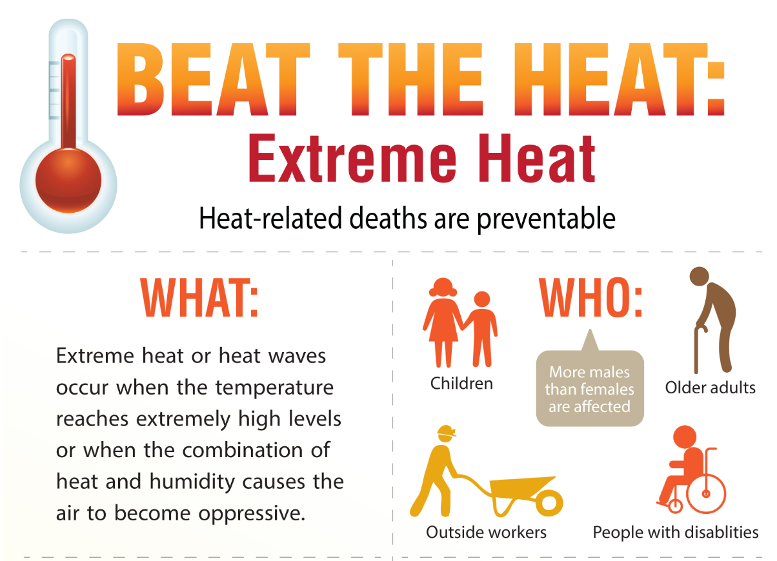
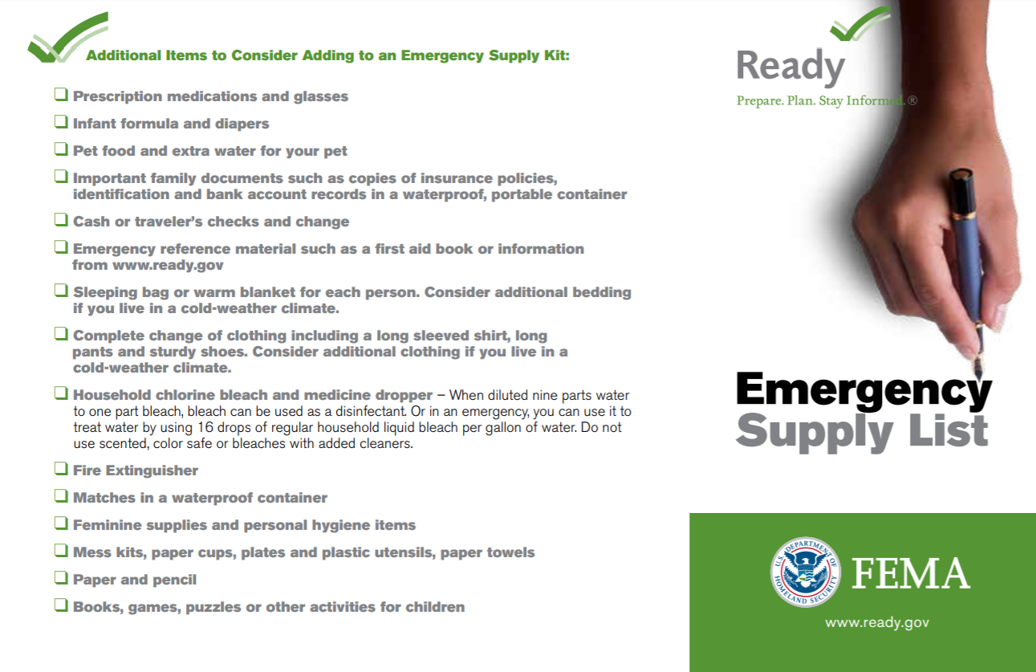
Requires adaptation in our clinical practice…
https://www.cdc.gov/cpr/infographics/beattheheat.htm
https://www.ready.gov/sites/default/files/2021-02/ready_checklist.pdf

Slide 18

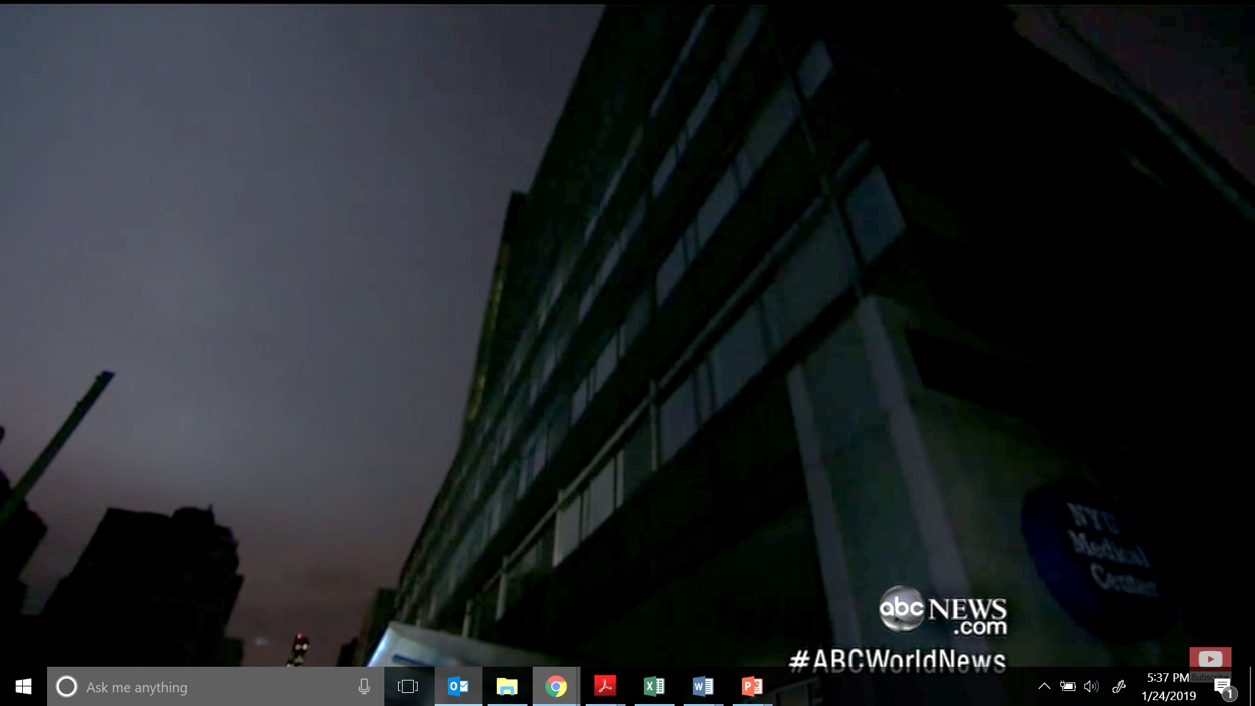
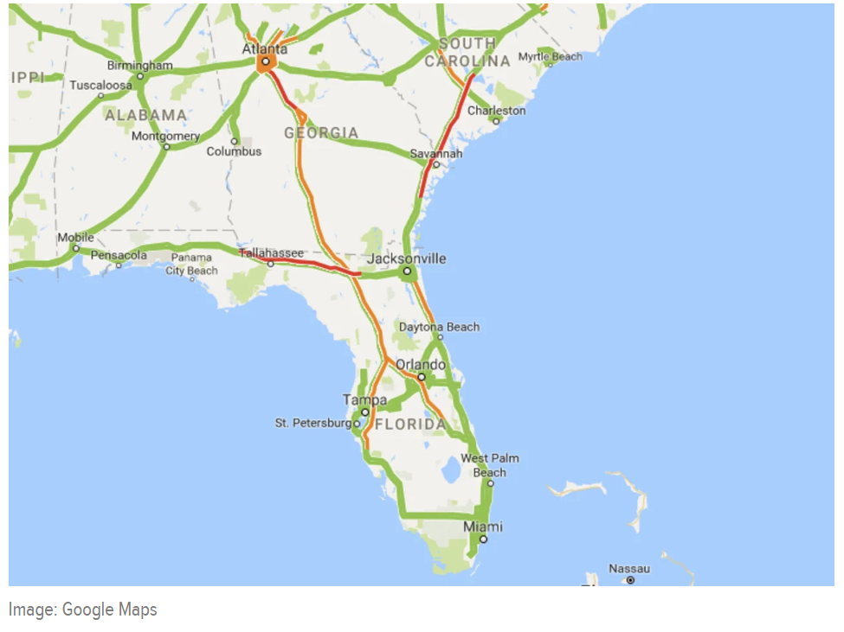
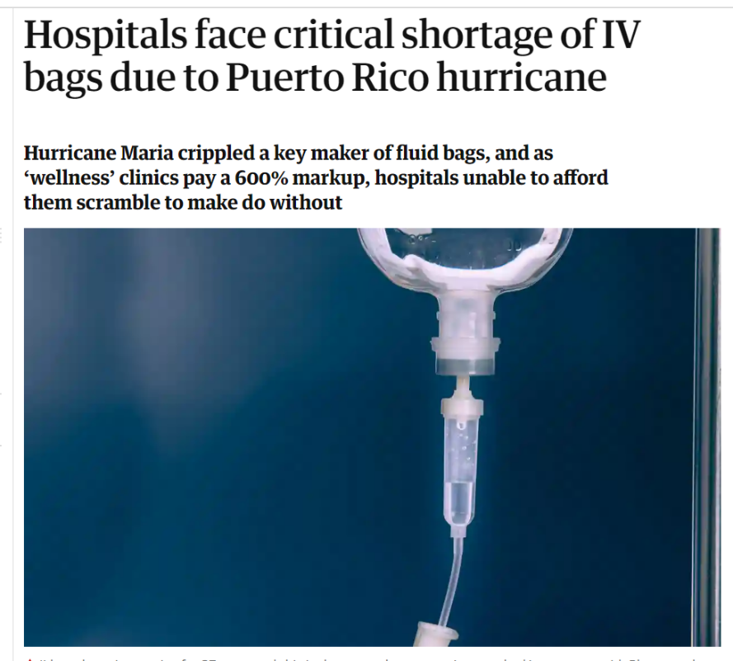

David Muir, ABC News, October 30, 2012
…and disrupts healthcare delivery.
The Guardian, January 10, 2018

Slide 19
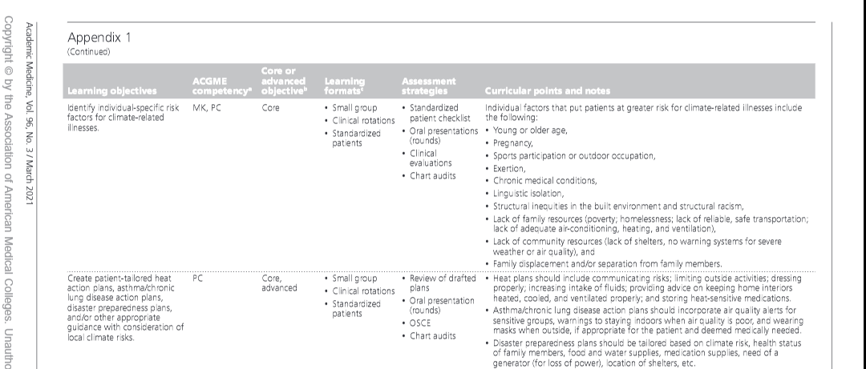
Sample learning objectives, formats, assessment strategies and curricular points.
Philipsborn RP, Sheffield P, White A, Osta A, Anderson MS, Bernstein A. Climate Change and the Practice of Medicine. Academic Medicine. 2021;96(3):355–367. doi: 10.1097/ACM.0000000000003719.

Slide 20
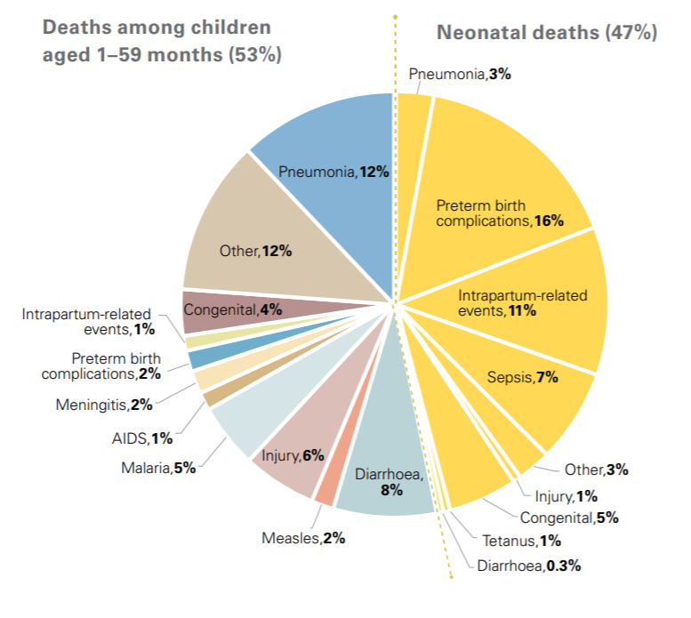





Example slide
A lever on causes of child death
Extreme heat
Malnutrition
Poor air quality
Extreme weather events
Vector borne diseases
Chart: UN Inter-agency Group for Child Mortality Estimation (UN IGME), ‘Levels & Trends in Child Mortality: Report 2019
Icons: 2019 Lancet Countdown on Health and Climate Change Policy Brief for the United States of America.

Slide 21
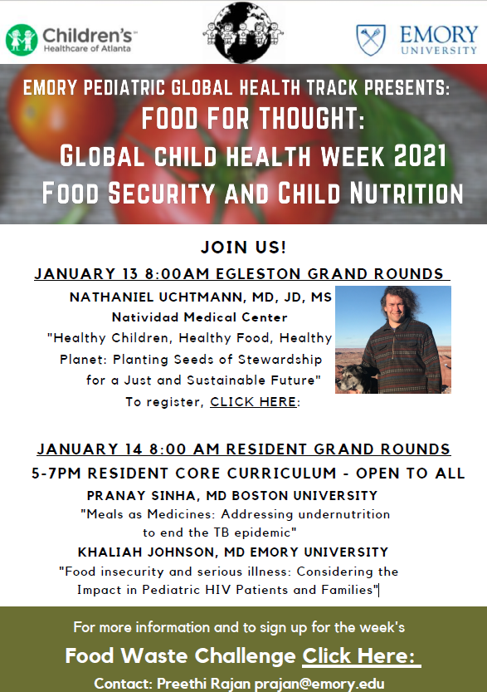
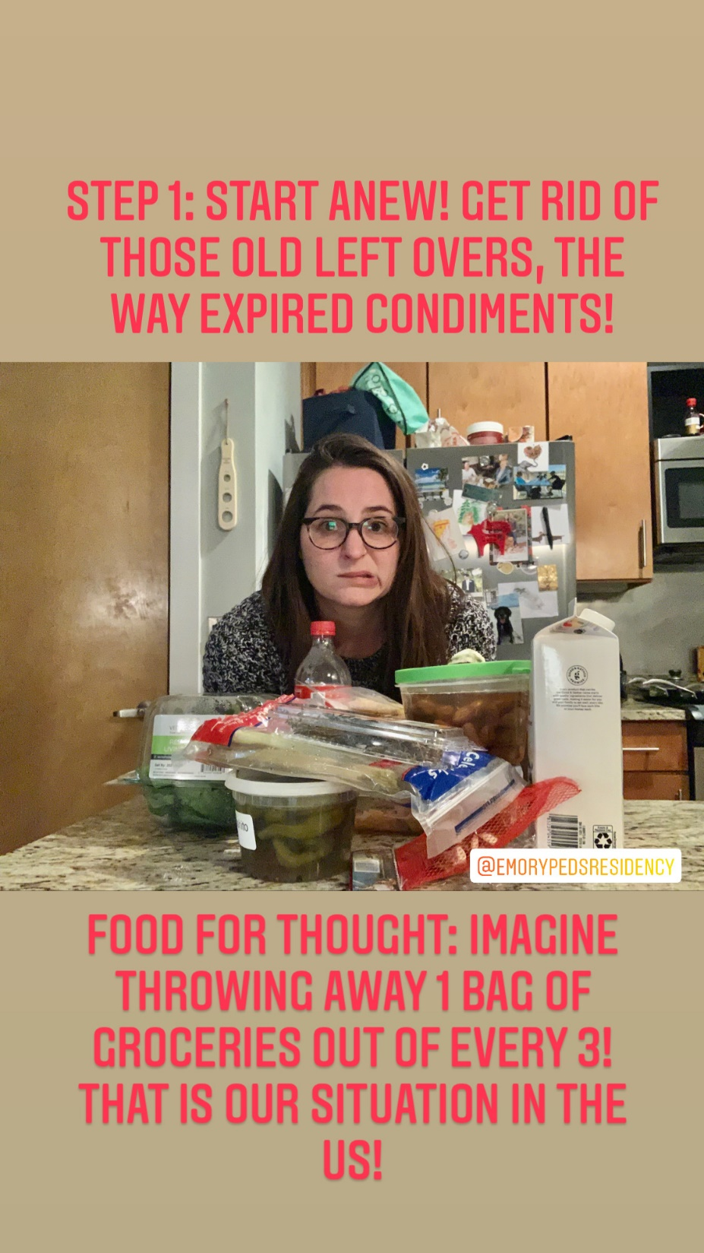
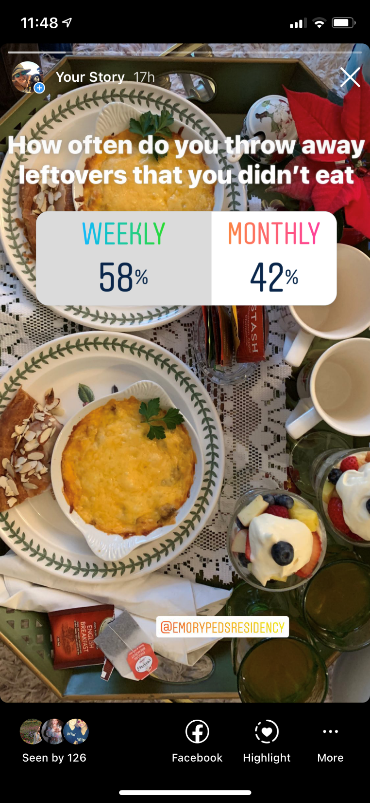
January 2021

Slide 22
Overview
2017
2018
2019
2020
2021
Pediatrics global health track
M3-M4 elective
Residency ed framework
M1-M2 foundations

Slide 23
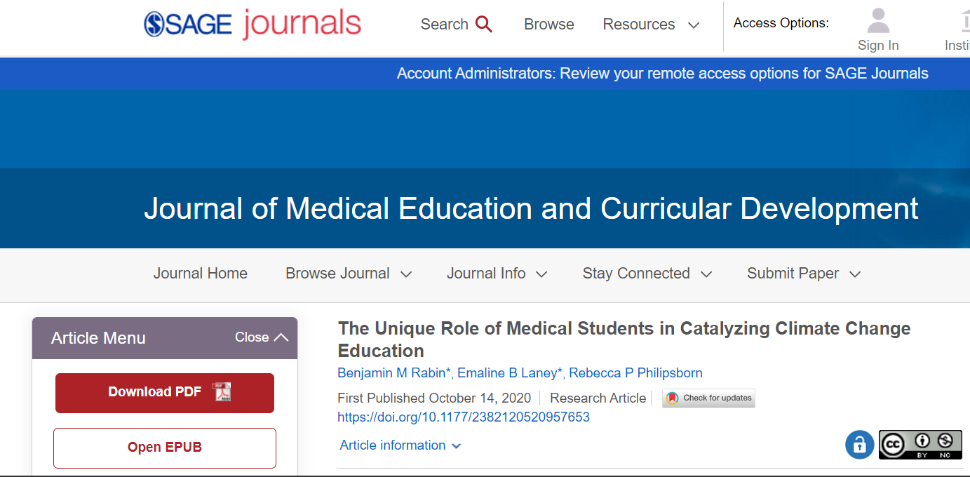
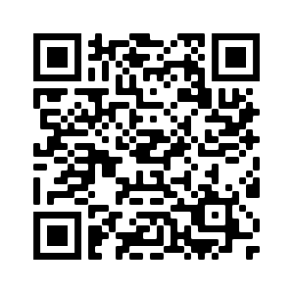
October 2020

Slide 24
Timeline for development
Climate and Environmental Health Curriculum Development Timeline (2019)
June
August
Presented proposal to Student Curriculum Committee
September
Presented proposal to faculty-led curriculum subcommittee.
October
Proposal shared and approved by Executive Curriculum Committee
November
Met with Pre-clinical Curriculum Director to plan implementation
Met with senior faculty member to discuss curricular feasibility
February
Identified climate and health mentor
May
Held climate and health interdisciplinary event for students
May–June
Brainstormed and outlined curriculum proposal
June–August
Real-time identification of longitudinal climate curricular links
At present
Ongoing implementation
It’s a process…and that’s OK.
Graphic thanks to: Emaline Laney and Ben Rabin

Slide 25


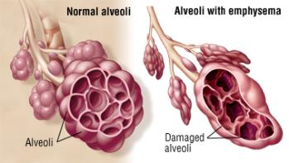
Example slide
Climate change intensifies drivers of common illnesses
→Assess for environmental determinants of health
→Talk to patients about exposures
→Know & refer to services in your community
→Advocate for big-picture change
Pollution contributes to asthma incidence and severity
Photo: https://www.health.harvard.edu/a_to_z/emphysema-a-to-z
  Learn the details of medicine. Don’t forget the big picture.

Slide 26
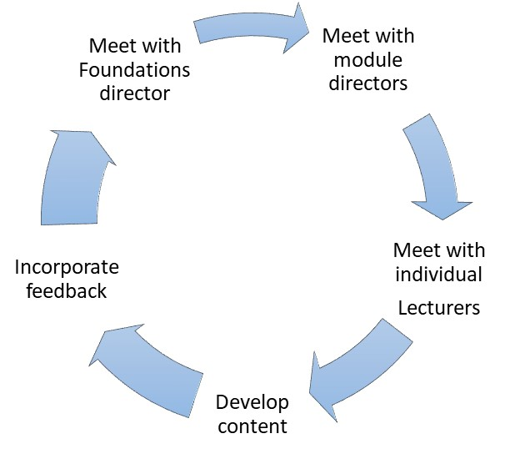
Process for implementation
Support with:
Slide or small group content
References
Talking points
Tailored to each lecturer
Sensitive to time

Slide 27
Pulmonology Module
Small group – pulmonary function tests, environmental determinants, redlining and racial justice
Lectures
  Asthma - Learning objective: Illustrate how particulate matter air pollution affects respiratory health in children and adults.
  Pediatric respiratory disorders - Learning objective: Describe how environmental pollution compromises pulmonary function and lung development.
  COPD - List sources of particulate matter pollution and differentiate between coarse (PM10) and fine (PM2.5) particulate matter.
Next round: student test questions and evaluations

Slide 28
Lessons learned for M1-M2 curriculum
Space is tight
Focus on pathophysiology is paramount
Engage faculty and student leaders in social justice
Form partnerships early on
Prioritize the evidence base
Content should be adaptable
Graphic thanks to: Ben Rabin and Emaline Laney

Slide 29
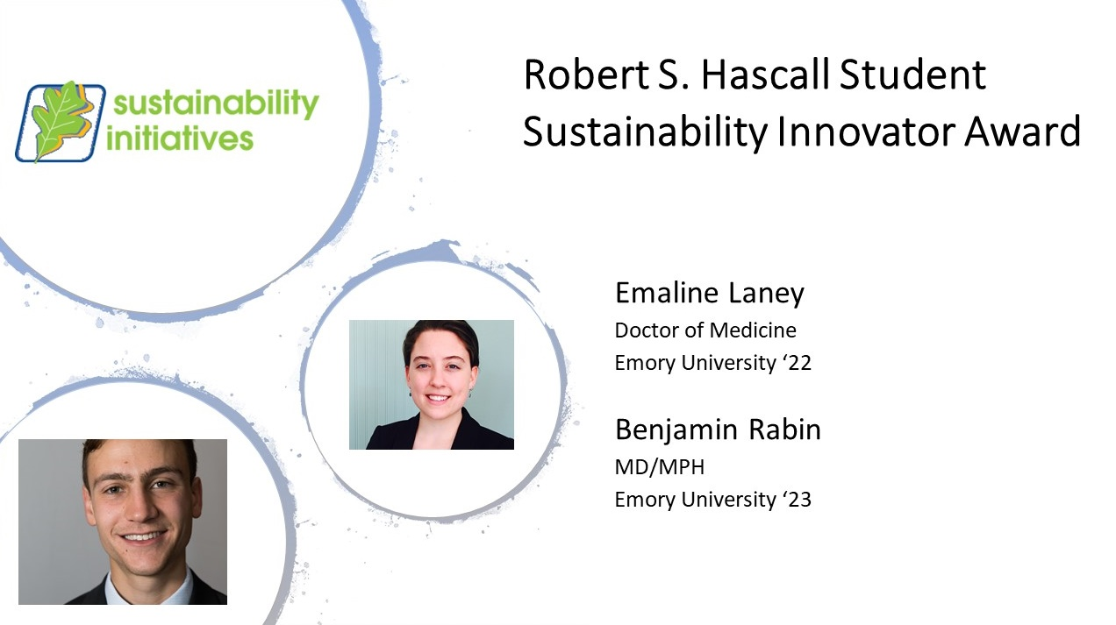
@EmoryMSCA

Slide 30
The way forward
Adapt as we go
Continue with co-creation of knowledge framework
The process is important
Evaluation
Time
Necessity
Momentum

Slide 31
Realms of synergy across the academic medical center
Sustainability & wellness initiatives
Social medicine and racial justice
Patient quality and safety, quality improvement
Antibiotic stewardship
Research efforts and programs
Pediatrics & Global Health
State professional societies and advocacy
??Recruitment

Slide 32



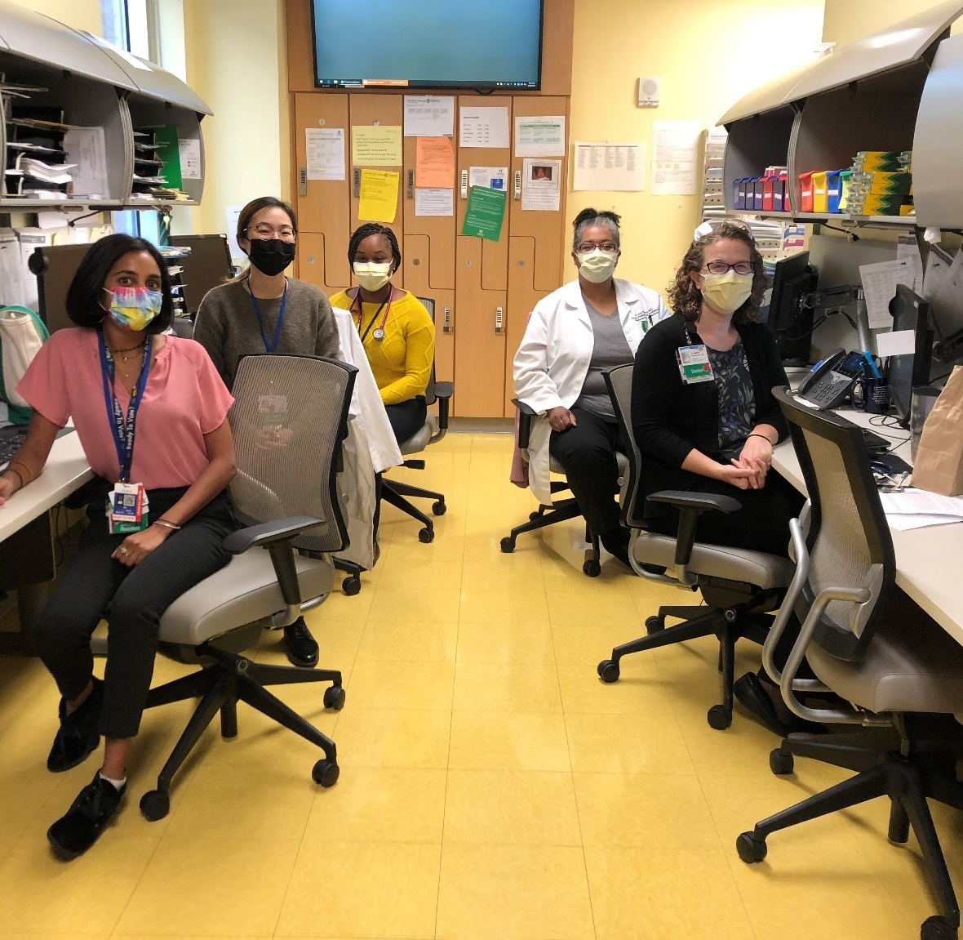
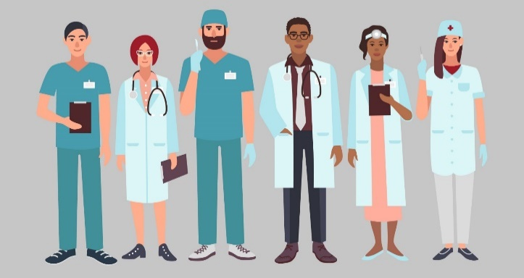








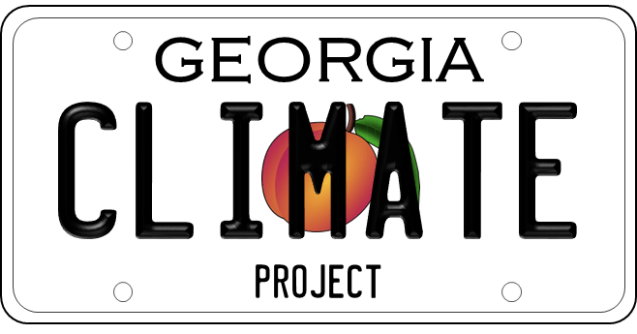
Hosts
It takes a village…
Sponsors
Partners

Slide 33
Resources referenced
  Resident Curriculum Framework:
  Philipsborn RP, Sheffield P, White A, Osta A, Anderson M, Bernstein A. “Climate Change and the Practice of Medicine: Essentials for Resident Education.” Academic Medicine. Online September 8, 2020. https://journals.lww.com/academicmedicine/Abstract/9000/Climate_Change_and_the_Practice_of_Medicine_.97003.aspx
  Perspective on M1-M2 Curricular Implementation @Emory :
  Rabin B, Laney E, Philipsborn RP. “The Unique Role of Medical Students in Catalyzing Climate Change Education.” Journal of Med Ed Curr Dev. Online October 14, 2020.
  https://journals.sagepub.com/doi/full/10.1177/2382120520957653
  Virtual elective for medical students:
  https://sustainability.emory.edu/climate-change-elective-for-medical-students-virtual-classes-and-recordings-in-spring-2020/

